Slide 1
OPTIMIZATION PROBLEMS
TRANSPORTATION PROBLEM
APPLICATION IN WATER RESOURCES MANAGEMENT
Jovana Andrijevic

Slide 2
Initial data
A simplified scheme of the water management system
(WMS) is presented on Fig. 1.

Slide 3

Initial data
According to initial data provided in Terms of Reference (TOR):
The water users are 3 Irrigation Fields (IFs), together with their Regulating Reservoirs (RRs) which are located at a command elevation above the IFs
3 water sources – pumping stations (PS 1) abstracting water from a reservoir, a pumping station (PS 2) abstracting surface water and a pumping station (PS 3) abstracting groundwater.
These water sources are namedА₁, А₂ и А₃
The water sources have supply capacities of the following volumes of water per day (in thousands m³):
Water users are named В₁, В₂ и В₃
Each water source A_{i} can supply water to each water user B_{j}.

Slide 4
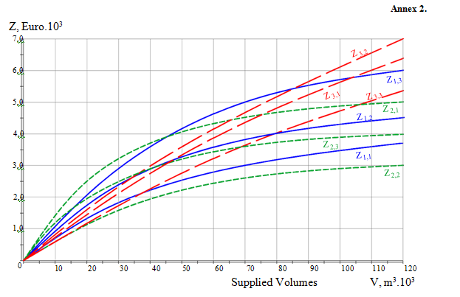
Initial data
The costs Z_{i,j} for water delivery from each water source A_{i} to each water user B_{j} are shown in Annex 2 of TOR.
The costs Z_{i,j}are not constants, nor in linear relation to the volumes of water supplied from water source A_{i} to water user B_{j}.
Which is seen from the functions “Costs Z_{i,j}” versus “Supplied volumes V_{i,j}” are shown as graphs on Fig. 2
Fig. 2.
Water Supply
Cost Functions

Slide 5



Problem solution
2.1. Type of Transportation problem
The type of transportation problem is determined by checking if the total supply (total volumes available) is equal to the total demand:
It is evident that the problem is not balanced.
Deficit is 30m³.10³
A dummy water source is introduced A₄
Virtual capacity of the dummy water source is equal to the deficit

Slide 6


Problem solution
2.2. Objective Function and Constraints
The Objective Function (OF) is a total cost for supplying water from all water sources A_{i} to all water users B_{j}. The classic form of the OF is:
V_{i,j} are the volumes of eater supplied from water source A_{i} to all water user B_{j};
C_{i,j} – the unit costs for transporting (supplying) water from water source A_{i} to all water user B_{j}
.
A new form of OF is defined
where Z_{ij} = V_{ij}C_{ij}is the cost for supplying water from water source A_{i} to all water user B_{j} .

Slide 7
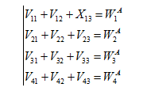

Problem solution
2.2.2. Constraints
a) Supply Constraints
These constraints take into account the capacity of water sources.
b) Demand Constraints
These constraints take into account the demand of water users.

Slide 8
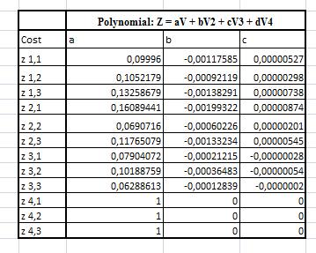
Creation of Solution Model in MS Excel
2.3.1. Cost functions
For each Cost function Z_{i,j} they are made 4 reading from graphs These constraints take into account the capacity of water sources.
Chart is inserted in MS Excel using the data from readings
For each function Z_{i,j}a trendline is added and the trendline equation is found
the Cost functions are described as polynomes
A check is performed in order to verify the trendline equations
The results are presented on Fig. 4.
Fig. 3. Cost functions
described as polynomes

Slide 9
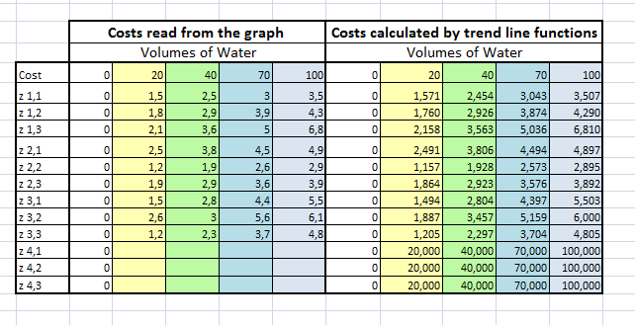
The results are presented on Fig. 4.
The Cost functions for the virtual water source – Z₄₁, Z₄₂и Z₄₃, are presented as linear functions, which return very high costs – 15 to 20 times bigger, compared to the costs for delivery from real water sources to water users

Slide 10
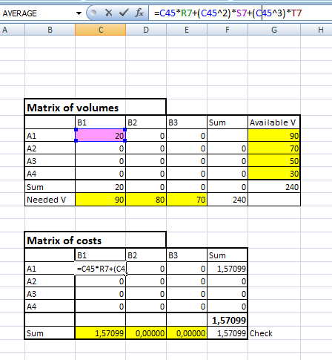
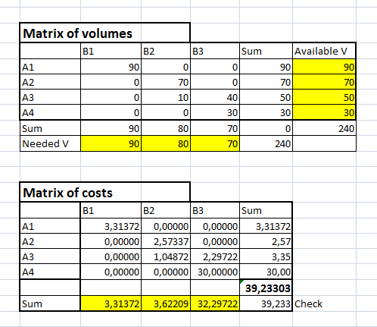
Creation of Solution Model in MS Excel
2.3.2. MS Excel model
Two matrices are made – the Matrix of volumes and Matrix of Costs
Fig. 4.

Slide 11
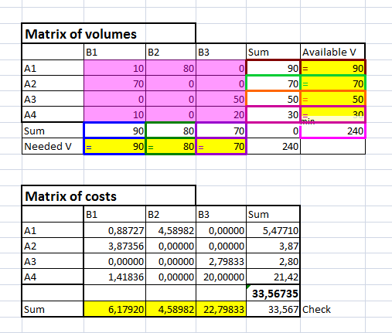
Creation of Solution Model in MS Excel
2.3.3. MS Excel Solver Solution
The solution of the task is obtained by means of the Solveradd-in tool ofMS Excel.
The results are presented in Fig. 6.
Fig. 6.
Problem solution
by means of
MS Excel Solver

Slide 12
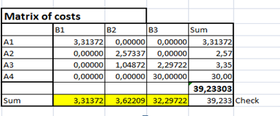
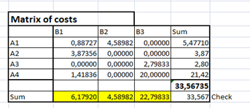
Creation of Solution Model in MS Excel
2.3.3. MS Excel Solver Solution
The real minimum of the Objective function is obtained by reducing the costs for delivery from dummy water source to water users. In this case the costs are
21 thousand Euro.
The real costs for water delivery are: Cost = 39,230– 33,567 = 5,663 thousand Euro or 5 663 €.
It can be seen from the table on Fig. 6, that the demand of the water users В₁and В₃ is not satisfied. It was evident that the system has a deficit of 30 000 m³ and the most economical solution is to have deficit of 10 000 m³ for water user В and deficit of 20 000 m³ for water user В₃.
This may not be satisfying solution for user B₃, because the deficit represents 28% of its demand.

Slide 13
Thank you for your attention.

